Slide 1

Energy-Efficient Neuromorphic Computing
MS Project: Mid Term Presentation
Khritish Kumar Behera 17125
Mail: khritish17@iiserb.ac.in
Indian Institute of Science Education and Research [IISER] Bhopal
Advisor: Dr. Kuntal Roy
Mail: kuntal@iiserb.ac.in
Date: 10-03-2022

Slide 2
Content
Recap
Motivation
Artificial Neural Network
Character Recognition Model
Spintronics
Magnetic Anisotropy
Magneto-elastic Anisotropy
Perpendicular Anisotropy
Giant Magneto-Resistance
Tunneling Magneto-Resistance
Neural network using spintronics
Multiferroic Composites
Proposed Device
Experimental
Measurement Automation with LabView
Ferromagnetic Resonance
Electromagnet
RF Signal Generator
Spectrum Analyzer
Lock-in Amplifier
Schottky Diode
Future Plan

Slide 3
Content
Recap
Motivation
Artificial Neural Network
Character Recognition Model
Spintronics
Magnetic Anisotropy
Magneto-elastic Anisotropy
Perpendicular Anisotropy
Giant Magneto-Resistance
Tunneling Magneto-Resistance
Neural network using spintronics
Multiferroic Composites
Proposed Device
Experimental
Measurement Automation with LabView
Ferromagnetic Resonance
Electromagnet
RF Signal Generator
Spectrum Analyzer
Lock-in Amplifier
Schottky Diode
Future Plan

Slide 4
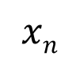
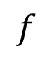
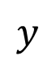
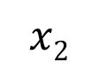
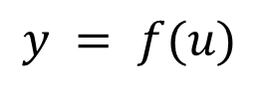
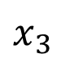
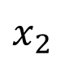
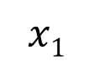
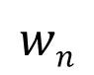

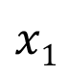
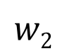
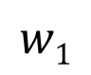
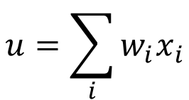
Energy-Efficient Neuromorphic Computing
Neuromorphic Computing is usually performed on traditional transistor based devices
$$u=\sum_{i}{w_{i}x_{i}}$$
$$x1$$
$$w1$$
$$y = f(u)$$
$$x2$$
$$w2$$
$$Σ$$
.
.
.
$$wn$$
Spintronic devices can be more energy-efficient than traditional transistors
$$f$$
$$xn$$
$$y$$
Piezoelectric
$$x1$$
Spintronic devices encapsulates
Weight, Sum and Threshold function
$$x_{2}$$
$$x_{3}$$
Neuron
Read
Insulator
Magnetostrictive
Write
Non-Boolean Computing

Slide 5
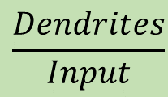
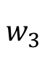
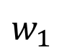

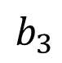
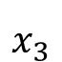
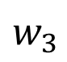
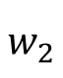
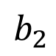
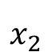
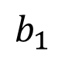
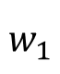
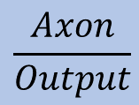
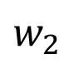
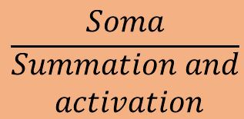
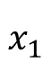
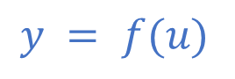
Artificial Neural Network (ANN)
$$w_{1}$$
$$b_{1}$$
$$\frac{Dendrites}{Input}$$
$$w_{2}$$
$$w_{1}$$
$$b_{2}$$
$$x_{1}$$
b
$$w_{3}$$
$$\frac{Soma}{\begin{aligned}Summation and \\ activation\end{aligned}}$$
$$w_{2}$$
$$x_{2}$$
$$Σ$$
$$b_{3}$$
$$w_{3}$$
$$x_{3}$$
Input layer
Hidden layer
Output layer
$$\frac{Axon}{Output}$$
$$y = f(u)$$
System of interconnected neurons
ANN Architecture
Output of a neuron, connected to all other neurons in the next layer
Three layers: Input, Hidden and Output layers
Weights and biases are the optimizing parameters

Slide 6
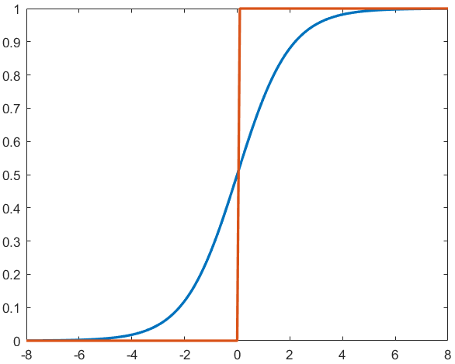
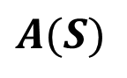
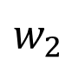
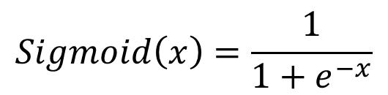

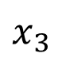

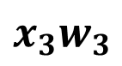
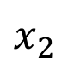
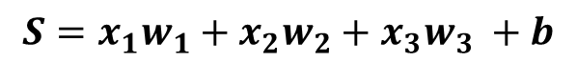
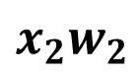
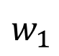
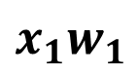
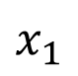
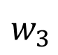
ANN: Sequential Process
Summation
Weight, strength of the edge
$$w_{1}$$
$$x_{1}$$
b
$$x_{1}w_{1}$$
b
$$w_{2}$$
$$x_{2}$$
$$Σ$$
$$x_{2}w_{2}$$
$$Σ$$
$$S=x_{1}w_{1}+x_{2}w_{2}+x_{3}w_{3} +b$$
$$w_{3}$$
$$x_{3}$$
$$x_{3}w_{3}$$
Bias, sets the activation function
$$Sigmoid\left(x\right)=\frac{1}{1+e^{−x}}$$
Activation
$$A(S)$$
Inspired from biological neuron
Non-linear function

Slide 7
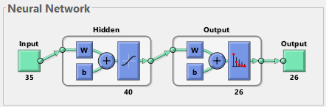
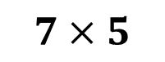
Artificial Neural Network: Neural Architecture
$$7×5$$
Input
35 (7x5)-bit word of the test character
Output
26-bit word suggesting the character
Input
A: 01110 10001 10001 11111
10001 10001 10001
Output
A: 10000000000000000000000000
B: 01000000000000000000000000

Slide 8
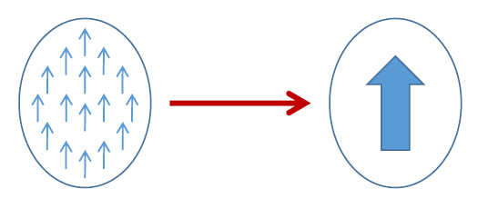
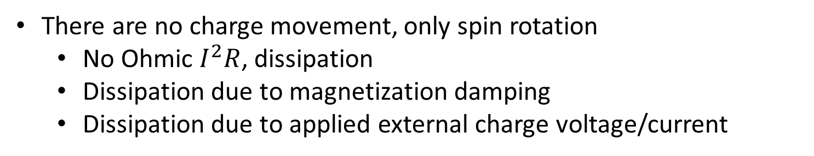

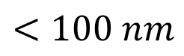
Spintronics: Spin-Electronics
UP
DOWN
0
1
Spin
Bits
Spin
$$e^{−}$$
Charge
Electron
Spintronic devices, advantages over transistor
non-volatile
endurable
There are no charge movement, only spin rotation
No Ohmic $I^{2}R$, dissipation
Dissipation due to magnetization damping
Dissipation due to applied external charge voltage/current
Electron Beam Lithography
$$<100 nm$$

Slide 9
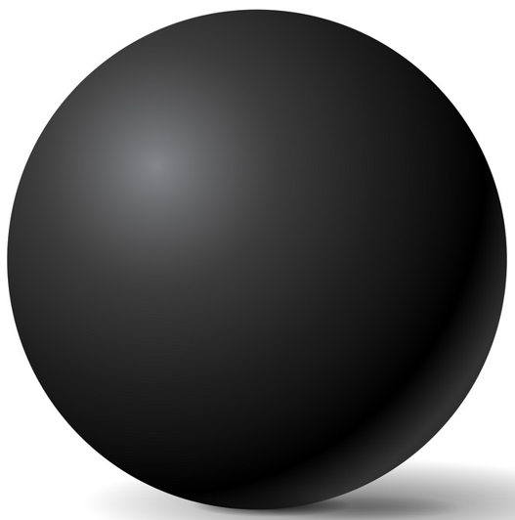
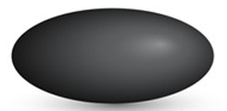


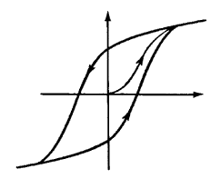










Magnetic Anisotropy
CoFeB
Sphere
Ellipsoid
Elliptical Cylinder
No anisotropy
Difficult to fabricate
In-plane
Shape anisotropy
x
Magnetization
30-80 KT at 300 K
$$E=\frac{1}{2}Ωμ_{0}M_{s}H_{k}\sin^{2}{θ}$$
$$ϕ$$
$$θ$$
$$E barrier$$
z
y
$$φ=±90^{o}$$
$H_{k}:$Coercive field
M
$Ω:$ Volume
$E_{barrier}=40$ KT,
10 years data retention time
H
$$θ={180}^{o}$$
$$θ=0^{o}$$
H_{k}

Slide 10







Magneto-elastic anisotropy
Magnetostrictive Materials: Certain ferromagnetic specimen changes its shape (strain$ε$:$∂l/l$) during the process of magnetization
Magnetic Anisotropy
Stress Anisotropy
$$σ:Stress$$
$$Ω:Volume$$
$$\frac{3}{2}λ σ Ω \cos^{2}θ$$
$$σ=Yε=Yd\frac{V}{t}$$
Cobalt:
$$\frac{3}{2}λ=−30×{10}^{−6}$$
FeGa:
$$\frac{3}{2}λ=150×{10}^{−6}$$
$λ:$ Magnetostriction Co-efficient

Slide 11
















Perpendicular Anisotropy
CoCrPt
z
z
Magnetization
direction
Easy axis:
$$θ=0^{o},{180}^{o}$$
$$θ= 0^{o}$$
Bulk
$$θ$$
Hard axis:
$$θ={90}^{o}$$
y
MgO
y
$$φ$$
CoFeB
x
x
$$θ={180}^{o}$$
t_{CoFeB}<1.3 nm
Magnet’s plane: $φ =±90^{o}$
Interface
$$E_{shape}\left(θ,φ\right)=\frac{1}{2}{ μ}_{0 }M_{s }^{2}Ω{ N}_{d}\left(θ,φ\right)$$
$$N_{d−xx}+N_{d_{−}yy}+N_{d−zz}=1$$
$$N_{d}\left(θ,φ\right)=N_{d−xx}\sin^{2}{θ}\cos^{2}{φ}+{N_{d−yy}\sin^{2}{θ}sin}^{2}{φ}+{N_{d−zz} cos}^{2}{θ}$$
$$E_{shape}\left(θ,φ\right)=\frac{1}{2}μ_{0}M_{s}[H_{k}+H_{d}\cos^{2}{φ]Ω\sin^{2}{θ}}$$
$$HPMA=H_{k}+H_{interface}$$
Circular cross-section
$$H_{d}=\left(N_{d_{−}xx}−N_{d_{−}yy}\right)M_{s}$$
$$=0$$
$$E_{PMA}\left(θ\right)=\frac{1}{2}{ μ}_{0 }M_{s}{ H}_{PMA} Ω\sin^{2}{θ}$$
$$H_{k}=\left(N_{d_{−}yy}−N_{d_{−}zz}\right)M_{s}$$
IISER Bhopal
Notes:
There are 2 kind of possibilities: Bulk anisotropy and Interface anisotropy
Where Nd(teta, phi) comes form -> spherical coordinate system
What is the requirement for perpendicular anisotropy

Slide 12







Perpendicular interface anisotropy
In-plane
sample
Out-of-plane
sample
z
$$N_{d_{−}zz}≫N_{d_{−}yy}≃1$$
$$k_{i}=1.3 mJ/m^{2}$$
MgO
Bulk
Interfacial anisotropy
$$tCoFeB<1.3 nm$$
$$\frac{K}{Ω}=\frac{1}{2}{ μ}_{0}M_{s}^{2}\left(N_{d_{−}yy}−N_{d_{−}zz}\right)+\frac{k_{i}}{tCoFeB}$$
y
CoFeB
x
Interface
$$\frac{K}{Ω}tCoFeB=−\left(\frac{1}{2}{ μ}_{0}M_{s}^{2}\right)tCoFeB+k_{i}$$
Ikeda, S. et al. "A perpendicular-anisotropy CoFeB–MgO magnetic tunnel junction."
Nature Materials 9 (2010) 721-724

Slide 13






Giant Magneto-Resistance (GMR)
Giant Magneto-Resistance (GMR)
$$GMR=\frac{1−0.55}{0.55}×100≃80\%$$
$$\text{Fe}$$
$$\text{Cr}$$
$$\text{Fe}$$
1988
A. Fert, M.N Baibich et al., Phys. Rev. Lett. 61, 2472 (1988)
P. Grunberg, G. Binash et al., Phys. Rev. B 39, 4828 (1989)
$$GMR[\%]=\frac{R\left(0\right)−R(H)}{R(H)}=\frac{RAP−RP}{R_{P}}×100$$

Slide 14









Tunneling Magneto-Resistance (TMR)
Insulator
e.g., Al₂O₃, MgO
Conductance is proportional to the density of states
N_{L}↑, N_{R}↑, N_{L}↓, N_{R}↓
Left (L)
Right (R)
Left (L)
Right (R)
$$G^{↑↑}∝N_{L}^{↑}{ N}_{R}^{↑}$$
$$G^{↓↓}∝N_{L}^{↓}{ N}_{R}^{↓}$$
$$G^{↓↑}∝N_{L}^{↓}{ N}_{R}^{↑}$$
$$G^{↑↓}∝N_{L}^{↑}{ N}_{R}^{↓}$$
$$EF$$
$$TMR=\frac{GP−G_{AP}}{GAP}$$
Reported 1975 (prior to GMR)
TMR>500% using MgO spacer
$${GP=G}^{↑↑}+ G^{↓↓}$$
$${GAP=G}^{↓↑}+G^{↑↓}$$
Julliere, M. Tunneling between ferromagnetic film. Phys. Lett. A 54, 225-226 (1975)
Moodera, J. S. et al., Phys. Rev. Lett. 74, 3273 (1995)
Mathon, J. et al., Phys. Rev. B 63, 220403 (2001), Butler, W. et al., Phys. Rev. B 63, 054416 (2001)
Yuasa, S. et al., Nature Mater. 3, 868 (2004), Parkin, S. et al., Nature Mater. 3, 862-867 (2004)

Slide 15
Content
Recap
Motivation
Artificial Neural Network
Character Recognition Model
Spintronics
Magnetic Anisotropy
Magneto-elastic Anisotropy
Perpendicular Anisotropy
Giant Magneto-Resistance
Tunneling Magneto-Resistance
Neural network using spintronics
Multiferroic Composites
Proposed Device
Experimental
Measurement Automation with LabView
Ferromagnetic Resonance
Electromagnet
RF Signal Generator
Spectrum Analyzer
Lock-in Amplifier
Schottky Diode
Future Plan

Slide 16





Multiferroic Composites
Multiferroic Composite
Multiferroics
Room-temperature operation
Weak magnetoelectric coupling
Magnetostrictive
Piezoelectric
E
Strain
P
$$\boxed{α_{ME}=μ_{0}\frac{∂M}{∂σ}\frac{∂σ}{∂E}}$$
Piezoelectricity
Magnetoelectricity (intrinsic)
$$\boxed{α_{ME}=μ_{0}\frac{∂M}{∂E}}$$
$$ε$$
M
$$σ$$
H
Magnetostriction

Slide 17




Multiferroic composites Voltage vs stress anisotropy
V_{in}
$$ε_{piezo}=d_{piezo}×\left(\frac{V_{in}}{t_{piezo}}\right)$$
$$ε_{mag}≃ε_{piezo}$$
$$σ=Yε_{mag}$$
Magnetostrictive
FeGa
Piezoelectric
t_{piezo}
PMNPT
strain transfer
Choose piezoelectric layer with high de-coefficient
Y: Young’s modulus
Magnetostrictive layer
with high $λ_{s}Y$
$$d=3000 pm/V$$
$$Y=250×{10}^{9} Pa$$
$$t=100 nm$$
$$V=50 mV$$
Stress Anisotropy (for FeGa):
$\frac{3}{2}λ σ Ω \cos^{2}θ$
$=2.4×{10}^{−18} J$ (max.)

Slide 18

Proposed Device
Electric Potential to Piezoelectric
$$y$$
Piezoelectric
Stress anisotropy in Piezoelectric
x₁
x₂
x_{n}
.
.
Stress anisotropy in Magnetostrictive
TMR
Magnetic anisotropy in Magnetostrictive
Insulator
Magnetostrictive
Inhibits the TMR
The piezoelectric material
Serves the purpose of summation
The different dimension of blue pillars
Serves the purpose of weight
Generation of variable voltage

Slide 19
Content
Recap
Motivation
Artificial Neural Network
Character Recognition Model
Spintronics
Magnetic Anisotropy
Magneto-elastic Anisotropy
Perpendicular Anisotropy
Giant Magneto-Resistance
Tunneling Magneto-Resistance
Neural network using spintronics
Multiferroic Composites
Proposed Device
Experimental
Measurement Automation with LabView
Ferromagnetic Resonance
Electromagnet
RF Signal Generator
Spectrum Analyzer
Lock-in Amplifier
Schottky Diode
Future Plan

Slide 20



Measurement automation with LabView
LabView
Graphical programming environment
Control and synchronize different devices from different companies
Centralized system for data acquisition

Slide 21


Measurement automation with LabView : Electromagnet
Creates a session with electromagnet’s controller for communication
Measures the magnetic field using the gauss probe
Terminates the session and stops further communication
Takes current as input, to set it in the electromagnet
PC with labview is connected to the controller
Gauss probe
The gauss probe and the electromagnet is also connected to the controller
Controller
Electromagnet

Slide 22


Measurement automation with LabView : RF Signal Generator
Creates a session with RF signal generator for communication
Configures the RF signal frequency
Configures the RF signal power level
Configures ON/OFF state of the signal generator
Terminates the session with RF signal generator
PC with labview is connected to the RF signal generator

Slide 23


Measurement automation with LabView : Spectrum Analyzer
Creates a session with spectrum analyzer for communicat-ion
Configures the spectrum analyzer
Fetch the trace from the device
Search position on trace to put marker
Retrieves data from the marker
Terminat-es the session with the device
PC with labview is connected to the Spectrum analyzer

Slide 24






Ferromagnetic Resonance
precession
LL Equation
$$\frac{ⅆM}{ⅆt}=−\left|γ\right| M×Heff− \frac{α\left|γ\right|}{M} M×M×Heff$$
damping
Transverse AC field
$$Hy(t)=Hy0{ ⅇ}^{ⅈωt}$$
Negative damping to keep the magnetization rotating
$$ω=\left|γ\right| \sqrt{H_{z}\left(H_{z}+M\right)}$$
In-plane FMR
$ω =\left|γ\right| (Hz−M$)
Perpendicular FMR

Slide 25





Ferromagnetic Resonance
precession
LL Equation
$$\frac{ⅆM}{ⅆt}=−\left|γ\right| M×Heff− \frac{α\left|γ\right|}{M} M×M×Heff$$
damping
Lorentzian
$$Imag(φ_{0})=\frac{−{\left|γ\right|}^{2}MH_{y0}α\left|γ\right|Mω}{{\left(ω_{0}^{2}−ω^{2}\right)}^{2}+{\left(α\left|γ\right|Mω\right)}^{2}}$$
FMR absorption is given by the imaginary part
$$Imag(φ_{0})=\frac{H_{y0}\left|γ\right|}{{\left(αω_{0}\right)}^{2}}$$
At $ω=ω_{0}$
FMR Signal
Derivative FMR spectra
$$H_{dc}$$
25

Slide 26




Ferromagnetic Resonance
precession
LL Equation
$$\frac{ⅆM}{ⅆt}=−\left|γ\right| M×Heff− \frac{α\left|γ\right|}{M} M×M×Heff$$
damping
Lorentzian
$$Imag(φ_{0})=\frac{−{\left|γ\right|}^{2}MH_{y0}α\left|γ\right|Mω}{{\left(ω_{0}^{2}−ω^{2}\right)}^{2}+{\left(α\left|γ\right|Mω\right)}^{2}}$$
FMR absorption is given by the imaginary part
$$Imag(φ_{0})=\frac{H_{y0}\left|γ\right|}{{\left(αω_{0}\right)}^{2}}$$
At $ω=ω_{0}$
FMR linewidth $ΔH$
Derivative FMR spectra
$$ΔH=\frac{αω_{0}}{\left|γ\right|}$$
Half width at half maximum (HWHM)
$$2 ΔH$$
$$ΔHpy=12.9 Oe$$
26

Slide 27




Ferromagnetic Resonance: Experimental Setup
Laptop with LabView
Spectrum Analyzer
Signal Generator
Controller
Electromagnet
$$H_{RF}$$
To Spectrum Analyzer
From Signal Generator
$$H_{DC}$$
Coplanar Waveguide

Slide 28
Ferromagnetic Resonance: Experimental Setup
Electromagnet
Sample
To Spectrum Analyzer
From Signal Generator
Co-planar waveguide
S
Spectrum Analyzer
RF Signal Generator
PC with LabView

Slide 29

Ferromagnetic Resonance: Result

Slide 30







Lock-in Amplifier
Signal
Amplitude$→10nV$
Frequency$→10kHz$
Good amplifier noise $→\frac{5nV}{\sqrt{Hz}}$
Bandwidth$→100kHz$
Gain$→1000$
Signal$=10nV×1000=10μV$
Noise$=\frac{5nV}{\sqrt{Hz}}×\sqrt{100kHz}×1000=1.6 mV$
PSD in Lock-in amplifier can detect the signal at $10kHz$ with bandwidth as narrow as $0.01 Hz$
$$Noise=\frac{5nV}{\sqrt{Hz}}×\sqrt{0.01Hz}×1000=0.5μV$$

Slide 31






Lock-in Amplifier
$$V_{s}$$
X
$$cos$$
$$V_{r}$$
S
$$sin$$
$$⁡+{90}^{0}$$
X
$$V_{s}=A_{s}cos⁡(2πf_{s}t+θ_{s})$$
$$V_{r}=A_{r}cos⁡(2πf_{r}t)$$

Slide 32



Lock-in Amplifier
$$V_{s}$$
X
$$V_{PSD}=V_{s}.V_{r}$$
$$cos$$
$$V_{r}$$
S
$$sin$$
$$⁡+{90}^{0}$$
X
$$f_{s}=f_{r}$$
$$V_{PSD}={\frac{1}{2}A}_{s}A_{r}\cos\left(\left(f_{s}+f_{r}\right)t+θ_{s}\right)−{\frac{1}{2}A}_{s}A_{r}\cos\left(\left(f_{s}−f_{r}\right)t+θ_{s}\right)$$
$$V_{PSD}={\frac{1}{2}A}_{s}A_{r}\cos\left(\left({2f}_{s}\right)t+θ_{s}\right)−{\frac{1}{2}A}_{s}A_{r}\cos\left(θ_{s}\right)$$
High frequency component
DC component

Slide 33









Lock-in Amplifier
$$V_{PSD}$$
In-phase
$$V_{s}$$
X
$$X$$
$$cos$$
LPF
$$R$$
$$V_{r}$$
S
$$θ$$
$$sin$$
$$⁡+{90}^{0}$$
X
$$Y$$
Quadrature
LPF
$$V_{PSD}$$
DC component
$$f_{s}=f_{r}$$
$$θ=\tan^{−1}{\frac{Y}{X}}$$
$$R=\sqrt{X^{2}+Y^{2}}$$

Slide 34

Lock-in Amplifier

Slide 35




Schottky Diode
$$R=1MΩ$$
$$C=1nF$$

Slide 36
What I have done
 | TASK | ECS501
 |  | MID-TERM | END-TERM
1 | Character recognition model implementation | ✓
2 | Magnetic thermal annealing |  | ✓
3 | Different experimental apparatus |  | ✓
4 | LabView for automation of different devices |  | ✓
 | TASK | ECS502
 |  | MID-TERM | END-TERM
1 | Electron beam lithography patterning | ✓
2 | Ferromagnetic Resonance setup in lab | ✓
3 | LabView for automation | ✓
4 | Worked on Lockin-Amplifier | ✓

Slide 37
Future Plans
 | TASK | ECS502
 |  | MID-TERM | END TERM
1 | Electron beam lithography
2 | Sputtering
3 | Characterization: VSM, FMR, TMR, PFM, MFM

Slide 38
?
Thank You

Slide 39

Ferromagnetic Resonance: Experimental Setup
Electromagnet
Helmholtz Coil
Sample
From Signal Generator
Schottky diode
Co-planar waveguide
S
Lock-in Amplifier
RF Signal Generator
PC with LabView

Slide 40
Ferromagnetic Resonance

Slide 41




Schottky Diode
$$R=1MΩ$$
$$C=1nF$$

Slide 43






Ferromagnetic Resonance
precession
$$\frac{ⅆM}{ⅆt}=−\left|γ\right| M×Heff− \frac{α\left|γ\right|}{M} M×M×Heff$$
damping
$$ω^{2}={\left|γ\right|}^{2}(H_{z}+\left(N_{yy}−N_{zz}\right)M)(H_{z}+\left(N_{xx}−N_{zz}\right)M)$$
In-plane FMR
$$ω=\left|γ\right| \sqrt{H_{z}\left(H_{z}+M\right)}$$
$$N_{xx}=N_{zz}=0, N_{yy}=1$$
Perpendicular FMR
$ω =\left|γ\right| (Hz−M$)
$$N_{xx}=N_{yy}=0, N_{zz}=1$$
For linearized small rotation
$$\frac{d^{2}φ}{dt^{2}}+α\left|γ\right|M\frac{dφ}{dt}+ω_{0}^{2}φ=0$$
$$ω_{0}=\left|γ\right| \sqrt{H_{z}\left(H_{z}+M\right)}$$
In-plane FMR

Slide 44



Ferromagnetic Resonance
precession
$$\frac{ⅆM}{ⅆt}=−\left|γ\right| M×Heff− \frac{α\left|γ\right|}{M} M×M×Heff$$
damping
$$ω^{2}={\left|γ\right|}^{2}(H_{z}+\left(N_{yy}−N_{zz}\right)M)(H_{z}+\left(N_{xx}−N_{zz}\right)M)$$
$$\frac{d^{2}φ}{dt^{2}}+α\left|γ\right|M\frac{dφ}{dt}+ω_{0}^{2}φ=0$$
Negative damping to keep the magnetization rotating
Transverse AC field
$$Hy(t)=Hy0{ ⅇ}^{ⅈωt}$$
$$Imag(φ_{0})=\frac{−{\left|γ\right|}^{2}MH_{y0}α\left|γ\right|Mω}{{\left(ω_{0}^{2}−ω^{2}\right)}^{2}+{\left(α\left|γ\right|Mω\right)}^{2}}$$
Lorentzian

Slide 45




Ferromagnetic Resonance
precession
$$\frac{ⅆM}{ⅆt}=−\left|γ\right| M×Heff− \frac{α\left|γ\right|}{M} M×M×Heff$$
damping
Transverse AC field
$$Hy(t)=Hy0{ ⅇ}^{ⅈωt}$$
$$Lorentzian=\frac{−{\left|γ\right|}^{2}MH_{y0}α\left|γ\right|Mω}{{\left(ω_{0}^{2}−ω^{2}\right)}^{2}+{\left(α\left|γ\right|Mω\right)}^{2}}$$
Derivative FMR spectra
FMR linewidth $ΔH$
$$2 ΔH$$
$$ΔH=\frac{αω_{0}}{\left|γ\right|}$$
Half width at half maximum (HWHM)
FMR Signal
Hdc

Slide 46



Ferromagnetic Resonance: Experimental Setup
Spectrum Analyzer
Electromagnet
Signal Generator
Lab Laptop
Gaussmeter
Gauss probe
Co-planar waveguide
I/P from Signal Generator
O/P to Spectrum Analyzer

Slide 47
Ferromagnetic Resonance: Experimental Setup
COIL 1
COIL 2
Electromagnet
PC with LabView
Lockin-Amplifier
Spectrum Analyzer
S
RF Signal Generator

Slide 48




Lock-in Amplifier
For retrieving signals buried in noise
Noise to signal ratio is high
Amplifying signal, amplifies noise
$$Signal=V_{s}sin⁡(ω_{s}t+θ_{s})$$
$$Reference=V_{r}sin⁡(ω_{r}t+θ_{r})$$
X
$$PSD=V_{s}\sin\left(ω_{s}t+θ_{s}\right).V_{r}sin⁡(ω_{r}t+θ_{r})$$
$$PSD=\frac{1}{2}V_{s}V_{r}\cos\left( {(ω}_{s}+ω_{r}\right)t+(θ_{s}+θ_{r}))−\frac{1}{2}V_{s}V_{r}\cos\left( {(ω}_{s}−ω_{r}\right)t+(θ_{s}−θ_{r}))$$
$$For ω_{s}=ω_{r}$$
$$PSD=\frac{1}{2}V_{s}V_{r}\cos\left( 2ω_{s}\right)t+(θ_{s}+θ_{r}))−\frac{1}{2}V_{s}V_{r}cos(θ_{s}−θ_{r}))$$
High frequency component
DC component

Slide 49


Lock-in Amplifier
Signal
Noise
PSD
500
600
Hz
0
100
1000
Hz
DC
component
High frequency
component
$$Signal:500Hz$$
$$Noise:600 Hz$$
$$Reference:500 Hz$$
$$τ=\frac{1}{2πf}$$
Trade off:
low cut-off frequency, higher settling time

